Slide 1
Enhance your React Native apps debugging using Flipper
By Dominic Garbett
Notes:
Welcome to my talk , "How to enhance your react native app debugging skills using flipper
In this talk, i'll walk you through some of the options available to us as developers for debugging react native applications
And with that how we can utilise these tools to get the most out of our workflow.

Slide 2


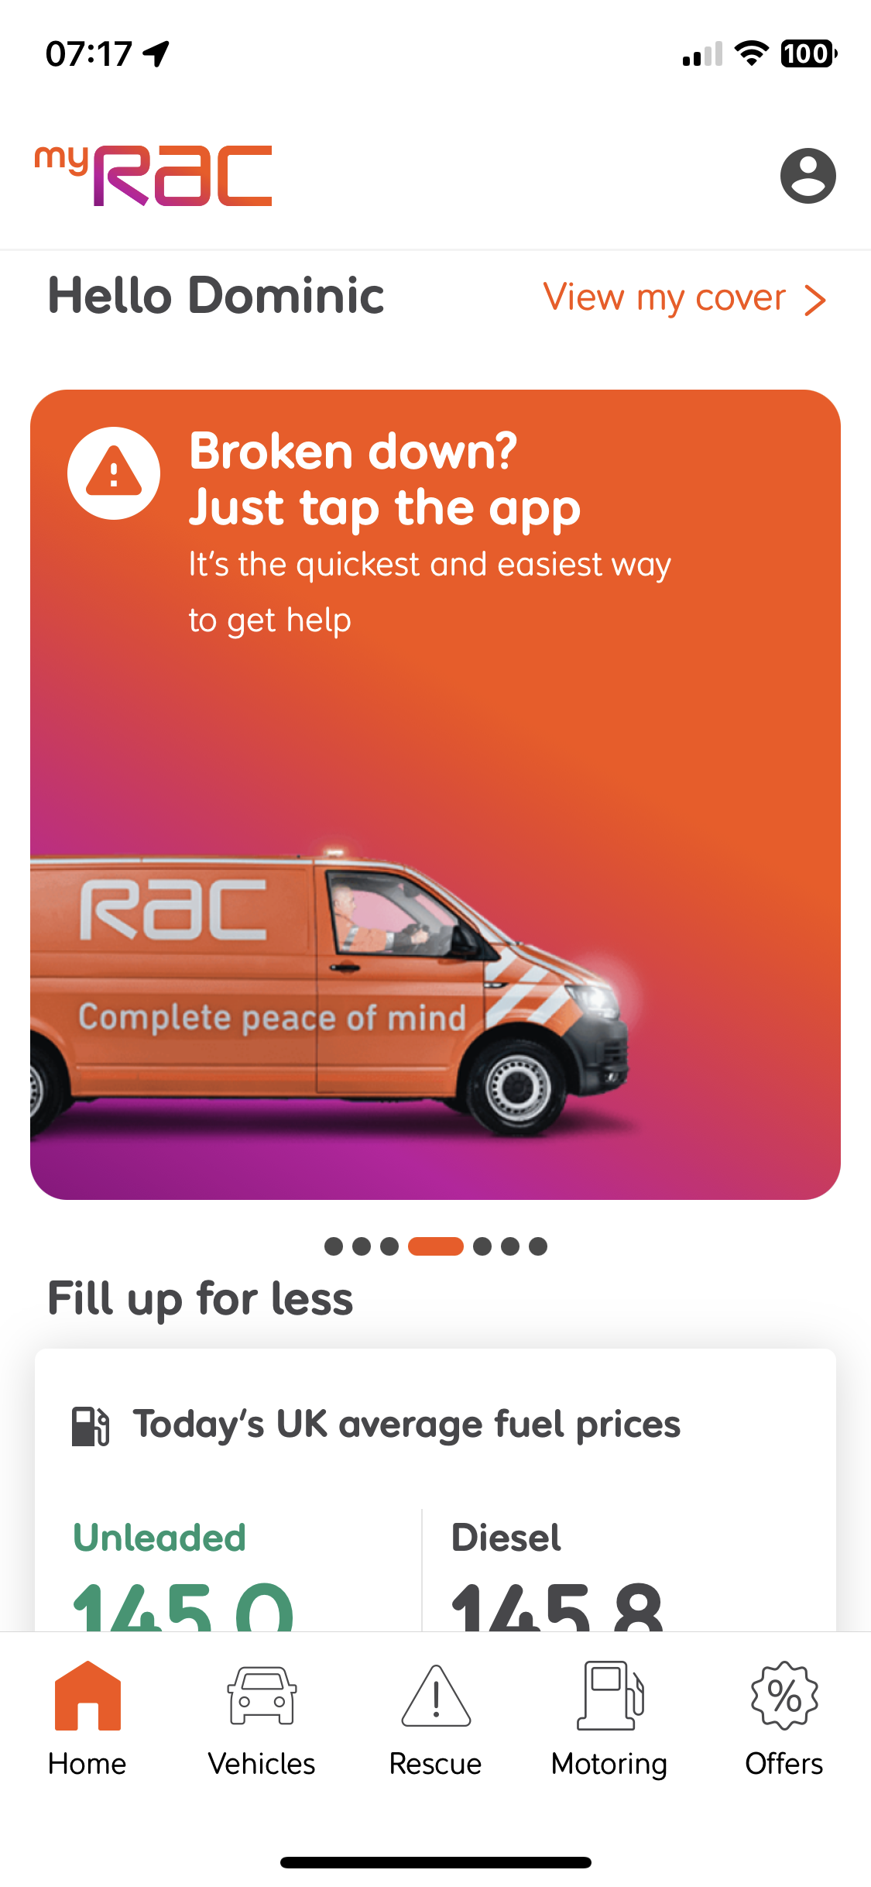
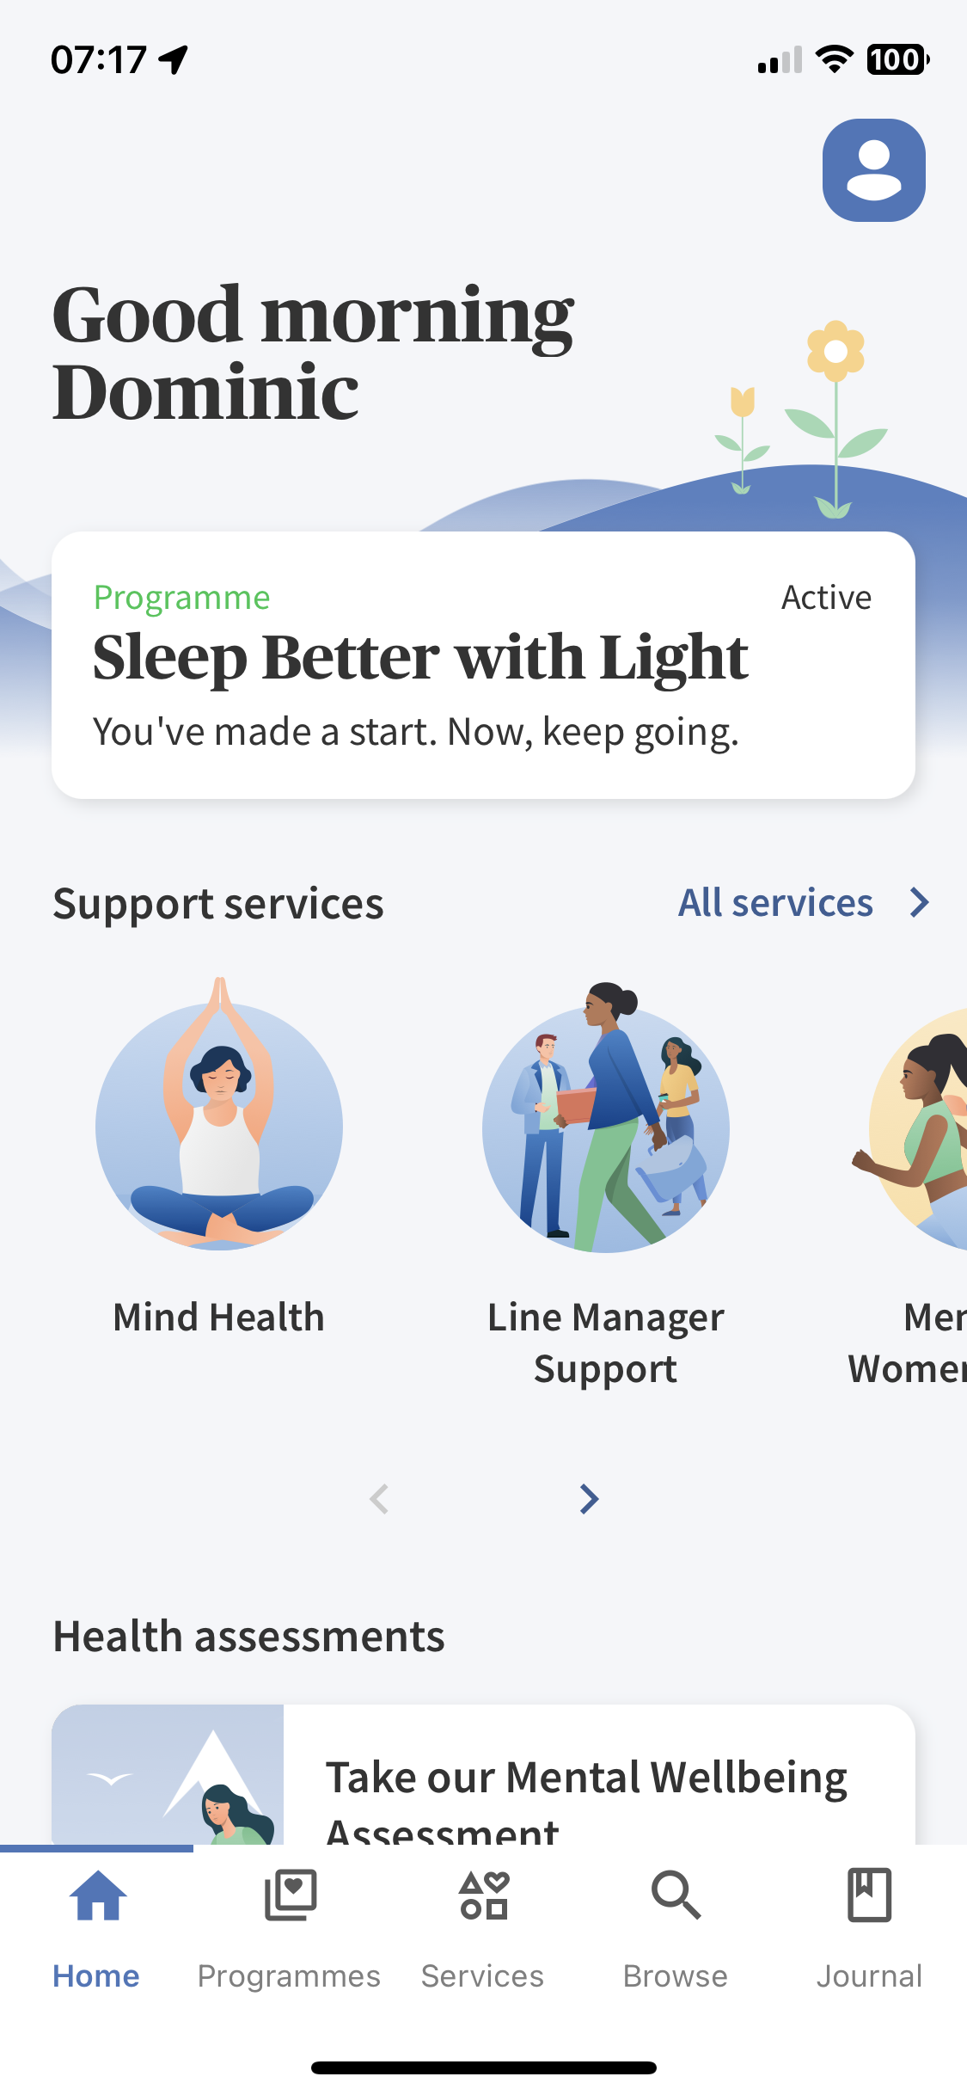
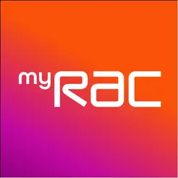

Who am I?
Senior Software Engineer @ Rac
Building mobile apps in React Native mainly in the insurance industry
Things I enjoy talking about
Developer Experience and building tooling to speed up delivery
Automated testing
How to build High performing agile squads
Cycling
Coffee
Notes:
So who Am I, I'm Dominic Garbett
A Senior Software Engineer at the RAC
-- I've been building mobile apps using react native mainly in the insurance industry both here at the RAC, and previously at AXA insurance for a number of years now
On the left you can see some of the apps I've shipped to production
If you get a chance to talk to me about anything, I'm most passionate about improving developer experience to speed up delivery,
Automated testing and how to empower high performing agile squads.
Non technically though, I enjoy road cycling ,and coffee

Slide 3


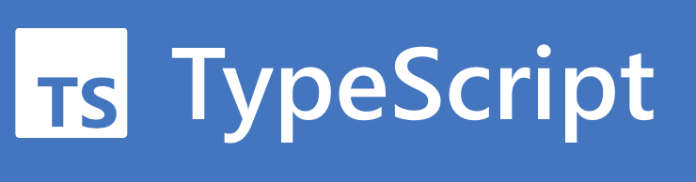
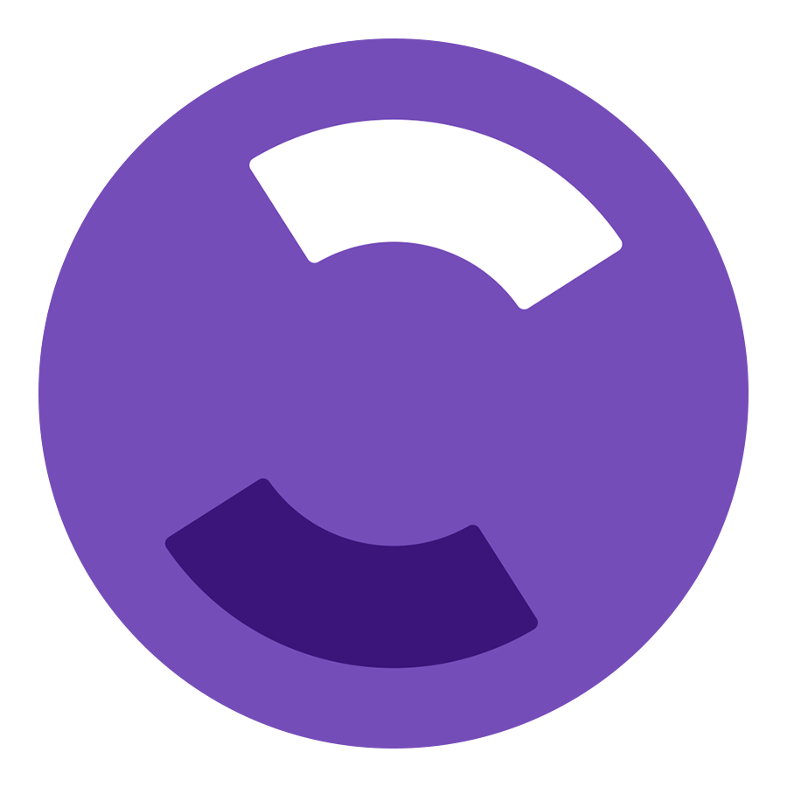
What is this talk about?
Notes:
What is this talk about ?
Lets get an idea of the audience
Who's used TS ? I'd imagine lots of you here
Who has used React Native ? Probably less but still some ?
And who is aware of Flipper and the debugging tooling that’s available for React Native
--Thats good,. i'll mainly be talking about Flipper and other debugging tooling that are available in react native during this talk

Slide 4
React Native is great, but debugging with a vanilla setup can be tricky
Too much time lost using console.log()
chrome Dev menu can be clunky and limited on what it offers
Tools such as Chrome dev tools uses remote debugging so experience isn’t the same as running JavaScript on a real device
Notes:
A software language is only as good as its tooling
--React native is great, but debugging with a vanilla setup can be tricky without knowing where to look
-- Far too much time is lost in using the console logger with logging output being cluttered and loud, making it difficult to quickly locate what you're looking for
--Tools such as Chrome dev tools use remote JS debugging meaning that they run the Javascript in chrome rather than natively on the device.
--This can cause funky irregularities when trying to debug things such as date times. If you work with react native long enough you're sure enough going to come across this problem sooner or later
-- In the past i've spent far too long , More than I care to imagine on working out why a time zone isn't working, only for the problem to be due to how my chrome dev tools is compiling the JS rather than how it works on a real device

Slide 5

What are the options ?
Tool | Component View | View application state | View Network requests | Profiler | Bidirectional Communication | Third party plugin system
Chrome Dev tools
React devtools
Reactatron
Flipper
Notes:
So what are the options,
Here are a number of the most popular supplementary debugging tools available and some of their feature sets
But what are they and why are they important?
Component View - > All about seeing the props + values of the component tree, as well as allowing you to change them on the fly
View application state – see what data we have in things like redux , TanStackQuery, Async Storage etc and understand what data is driving the way our app is functioning
View network requests -- See the HTTP request + responses easily in one place
Profiller - See how optimized your screen loads are and where, you might be able to speed up your application
Bi-directional communication , this helps us set up state and talk to the app from the debugger client
This can be very useful when trying to debug problems that occur deep in an application that require a number of different set up steps to get to.
One place I've found this extremely useful is when I was trying to debug an issue found on a screen that occurred half way through a 20+ step health age assessment. This allowed for me to navigate there straight away with state already set up
Third party plug-in system- what else is available to extend the custom tooling that is available
Obviously as we get further to the right of this table, your use case will dictate which tool you require
For a lot of peoples needs, chrome dev tools may be sufficent in getting to the root of your problem. As your app grows in size and complexity however it may become apparent that your needs are no longer being met and you may start to look elsewhere

Slide 6
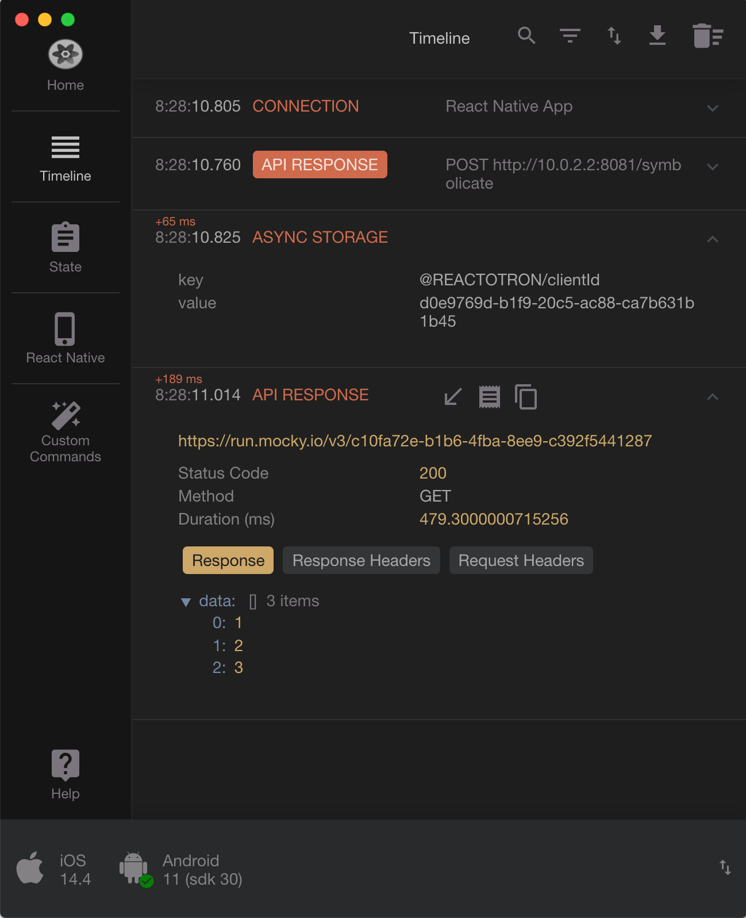
Reactatron
+ Really good at debugging app state
+ Network logs
+ Bi-directional communication
Not so good with extensibility
No third party plugins or the ability to create your own
Requires manual setup in your code
Notes:
So if you looked at the previous slide you'd probably assume it was down to either using flipper or reactatron
as they have most of the main feature you would require without having to download multiple tools
reactatron is built by Infinite red and the open source community
So why would you use reactatron ?
Really good at viewing logs and app state such as redux + MobX state tree. and allows you to see network logs straight away
Adding to this there is also the bidirectional aspect too ,allowing us to set up state and replay redux actions one by one
However, it does requires some manual set up in your code to get it working. and isn't fully supported by the react native team in an official capacity
And the key is that it's not extensible , there are no third party plugins and any features that you may want added needs to go via the open source project. Rather than being able to tailor make them for your needs straight away,

Slide 7
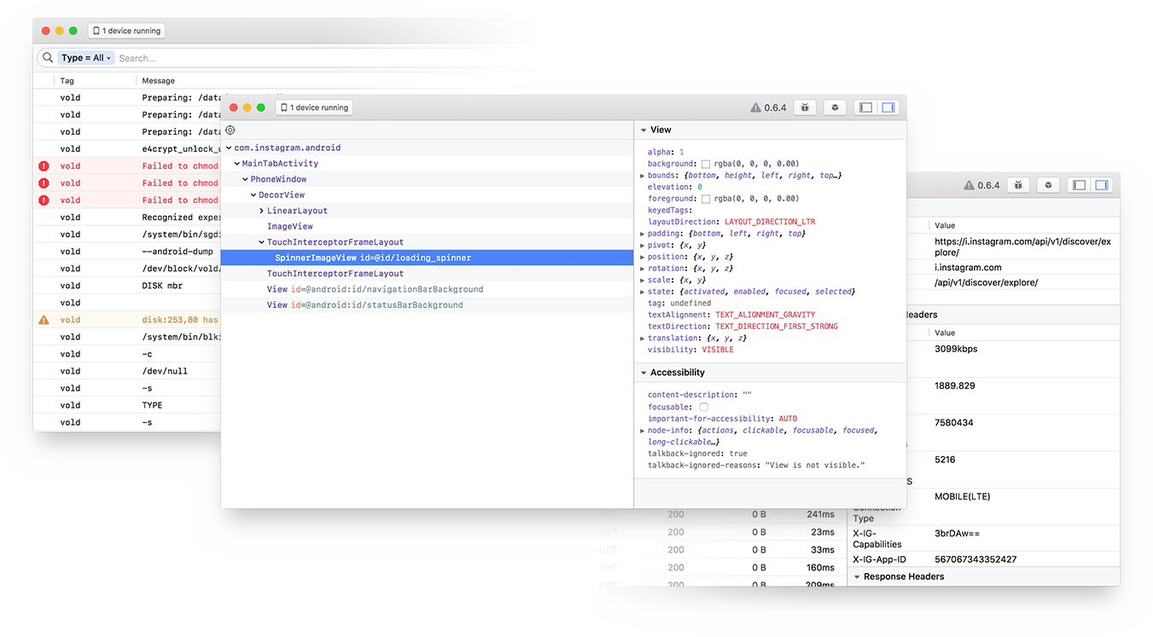
Flipper
Open sourced by Meta 2018
Debugging client for debugging iOS, android and React Native Apps
Built as a platform to be extensible ,with the ability to create your own plugins and consume others made by third parties.
Lots of third-party plugins available
Allow bidirectional communication between React Native and flipper client
Notes:
Flipper is a debugging client for both ios and android applications , which has a layer specifically for React Native Apps.
This means that not only can you debug your applications JavaScript , you also gain a whole host of debugging tools for the native device.
With that in mind it does pretty much everything reactotron does and more.
And probably the key difference and the main topic revolving around this talk is how flipper is more than a debugging client but a platform that can be built upon to establish bidirectional communication with your app so that you can tailor it to your needs.

Slide 8
Installing and using flipper
From React Native 0.62 out of the box vanilla installs of React Native – it just works
Notes:
But just how easy is installing flipper . From react native 0.62 it just works out of the box with a fresh install.
You just need to install the client application

Slide 9
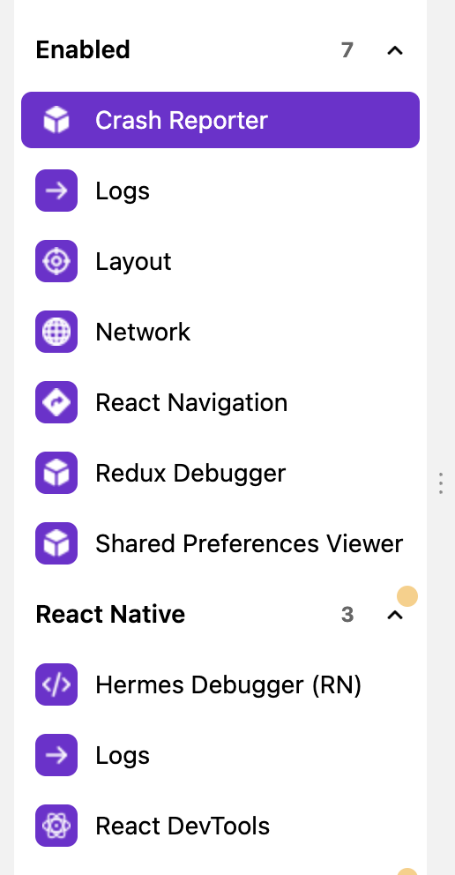
Plugins that have helped speed up my workflow
Notes:
Here, I'll show you flipper in action with a number of different plugins which have helped speed up my work flow.
I've built a small sample application using RTK query and react navigation which displays some data coming back from my favourite rick and morty api which will allow me to showcase some of the plugins that I find useful
These include but are not limited to
Network tab
React Navigation
Redux debugger

Slide 10
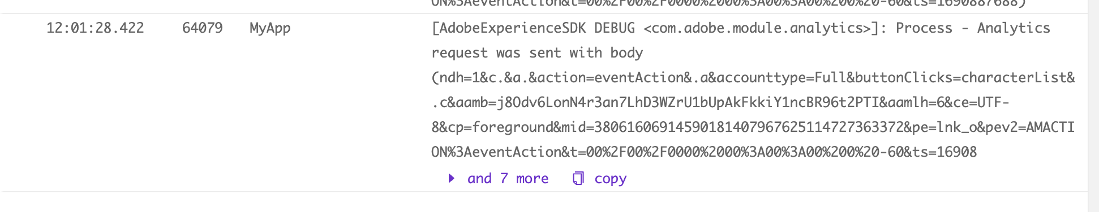
What can custom plugins help us with ?
Notes:
Out of the box plugins that can be installed through npm are great.
But one area we have found challenging to debug is our adobe analytics events. In that the events that were being fired were not showing up in our analytics platform. And at present there being no plugins created that fit our needs for showing adobe data.
In order to try and resolve this, we sought about creating a custom plugin that allows for clearly outputting the analytics events that were being sent.
As you can see from the image , here is what the current logging for analytics was looking like. Its difficult to see the key pairs that were being sent across at first glance, especially in a noisy logging window.
So how did we go about fixing this with a custom plugin ? Well, we attempted to separate out the adobe logs into a separate panel so we could understand the key tags that were being sent across.

Slide 11
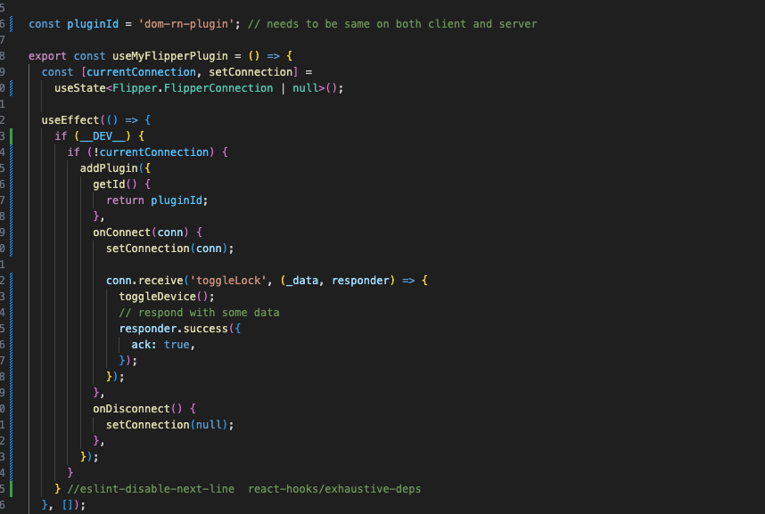
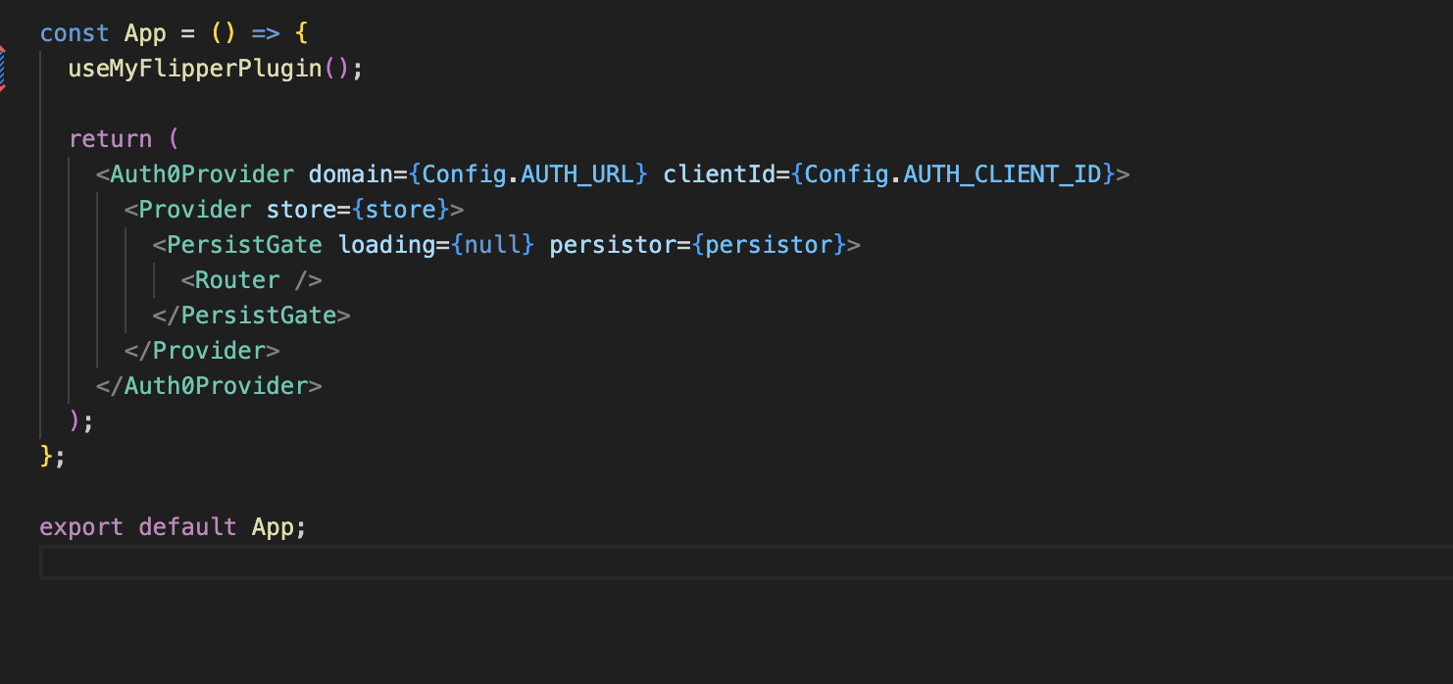
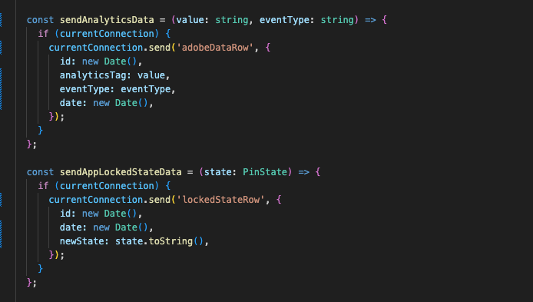
Building you own plugin – Adding to your app
Notes:
Here’s how we can add a custom plugin to our existing client application by creating a custom hook which creates the flipper connection through the addPlugin API.
Once that connection is established events are sent and received via this connection

Slide 12
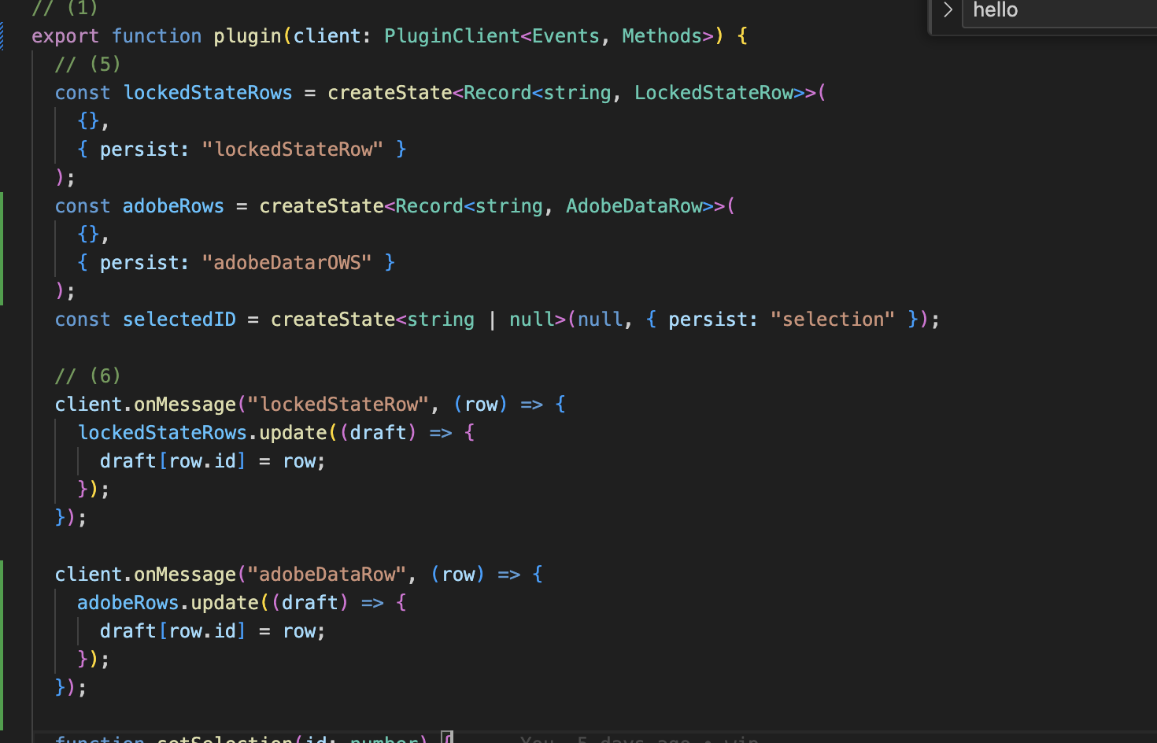
Building you own plugin – creating the client side
Built in react
Subscribes to the events sent via the application. Outputting them onto a component named plugin
Notes:
The custom UI that is being shown in the flipper client is built in react and subscribes to the same events set up in the application.
They establish a two directional flow which enables us to display and send data across easily

Slide 13
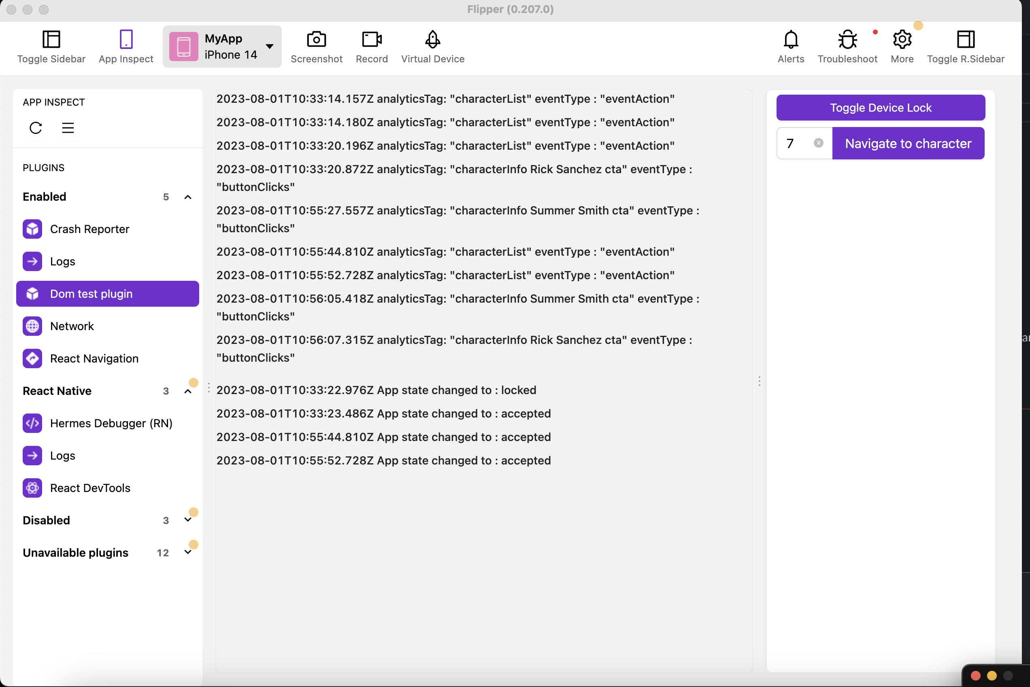
Demo of plugin
Notes:
Right, now to dig into some actual code and give you a showcase of what is possible in a small example plugin I’ve made for this talk.
It's built using typescript ,and utilizes the bidirectional communication aspect that I've been harping on about.
It will showcase how we display data coming back from events that are triggered from the locking and unlocking the app. As well as when adobe tracking events are being triggered.
It also has the ability to remotely change the locking state of the device as well as navigating to a specific rick and Morty character based upon the ID.
I hope from showing you this, it will help give some inspiration in how you may be able to build some custom tooling in order to speed up your workflow and reduce time to reproduce issues. Whether that be setting up your app in a specific state or splitting out some of your logs so that they are presented In a more desirable way to help diagnose problems quicker. Even if the UI is still very much a work in progress.

Slide 14

Thanks + questions

